Slide 1
MG-226 RankB Final project Viz
File created on: 12/8/2021 8:08:16 AM

Slide 2
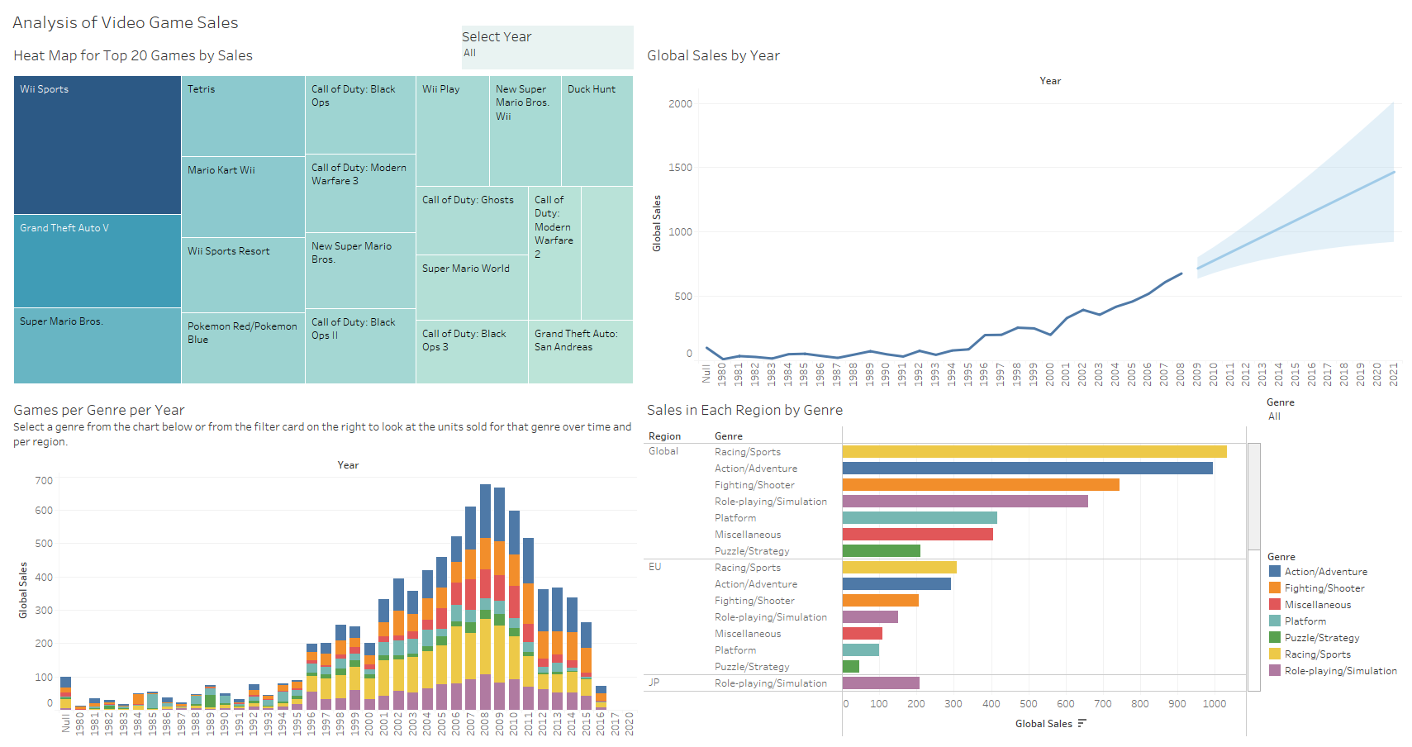

Slide 3
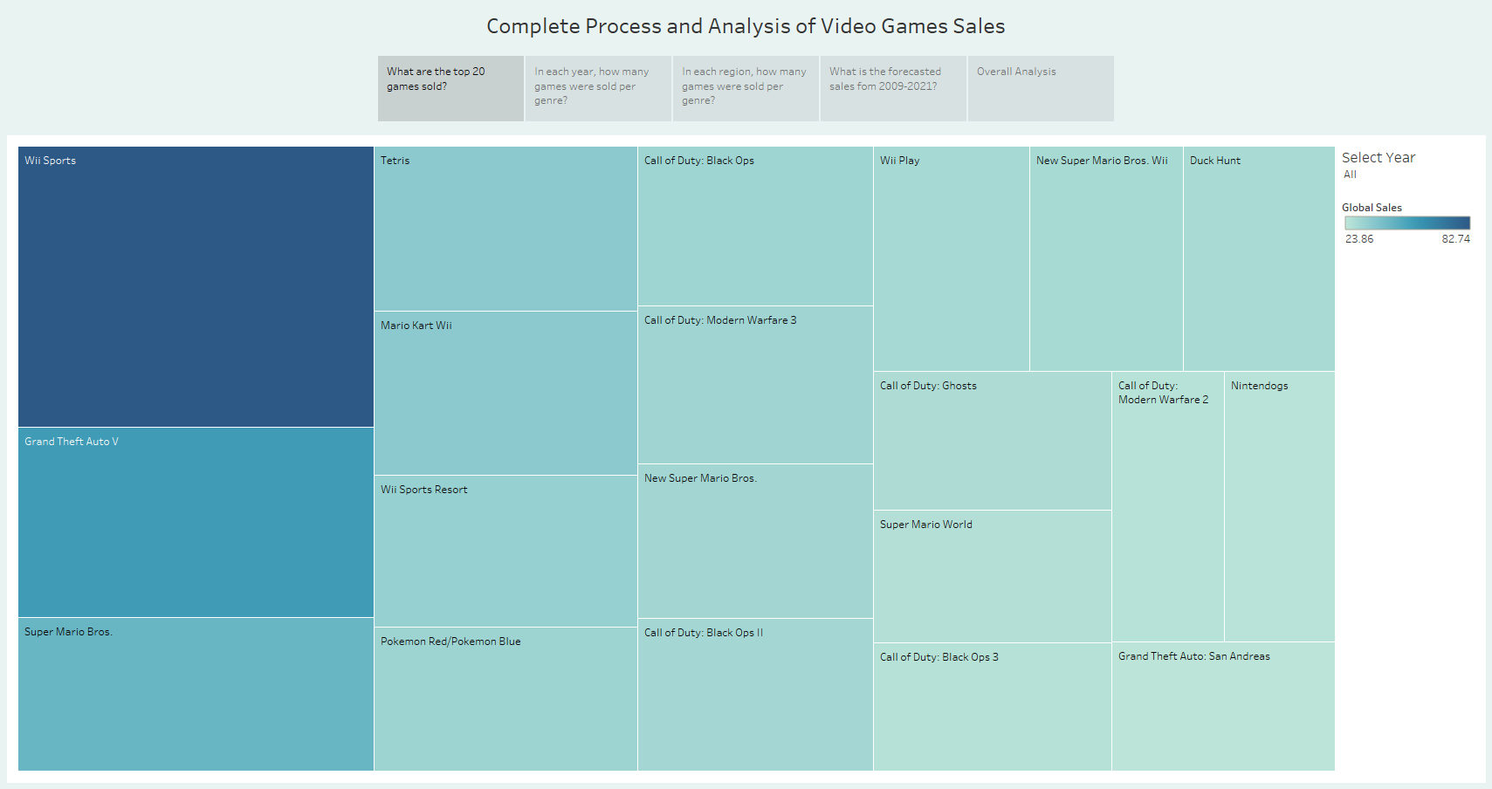

Slide 4
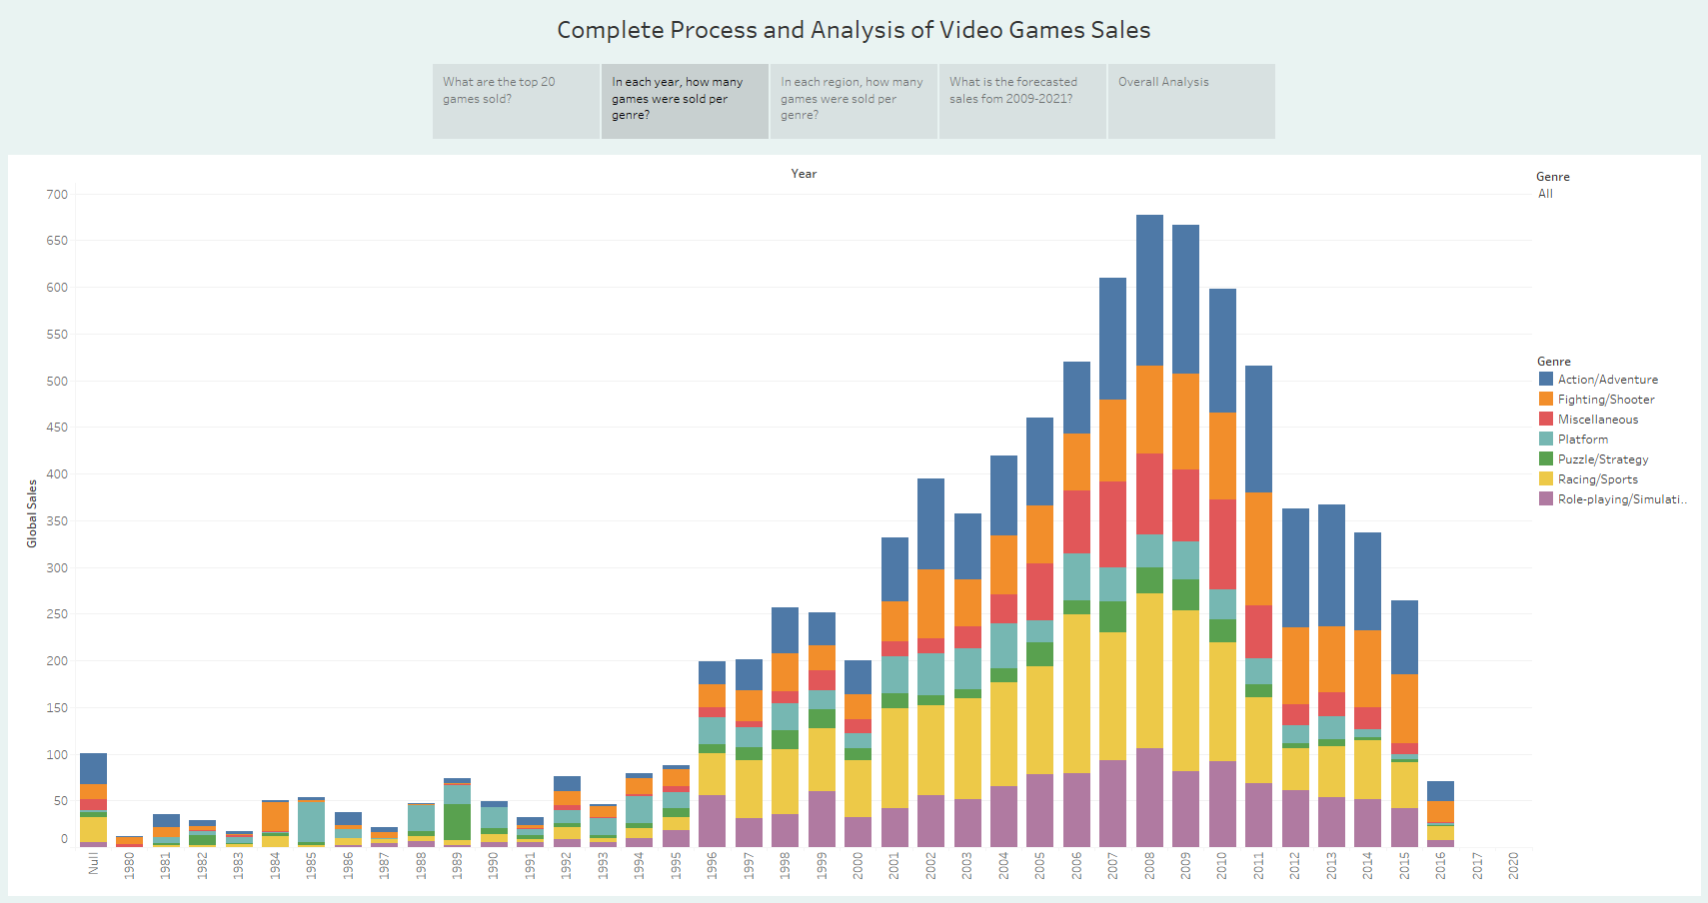

Slide 5
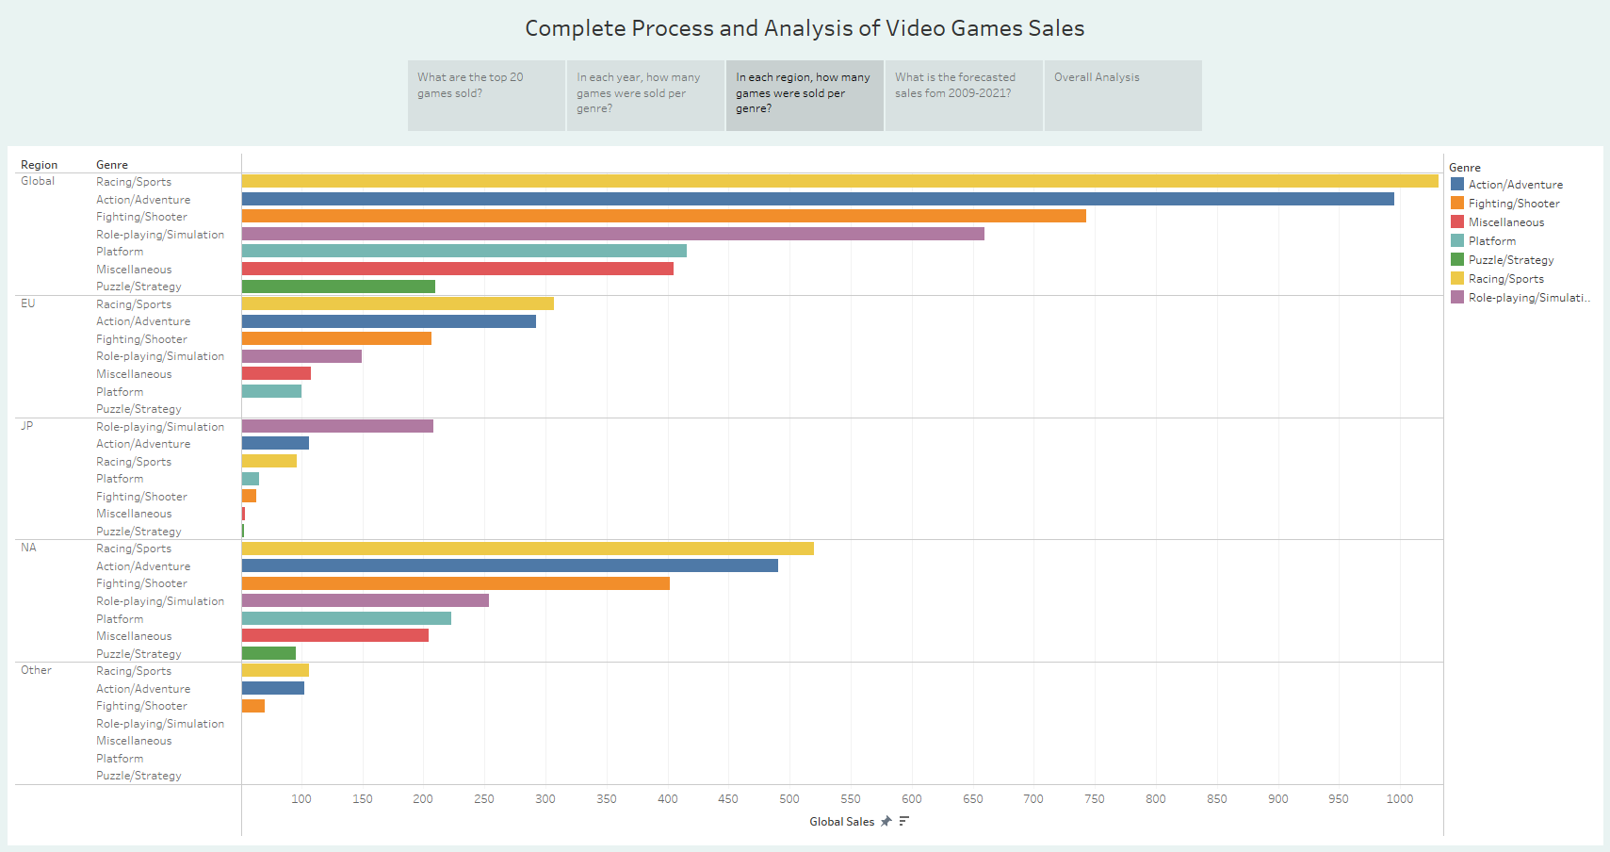

Slide 6
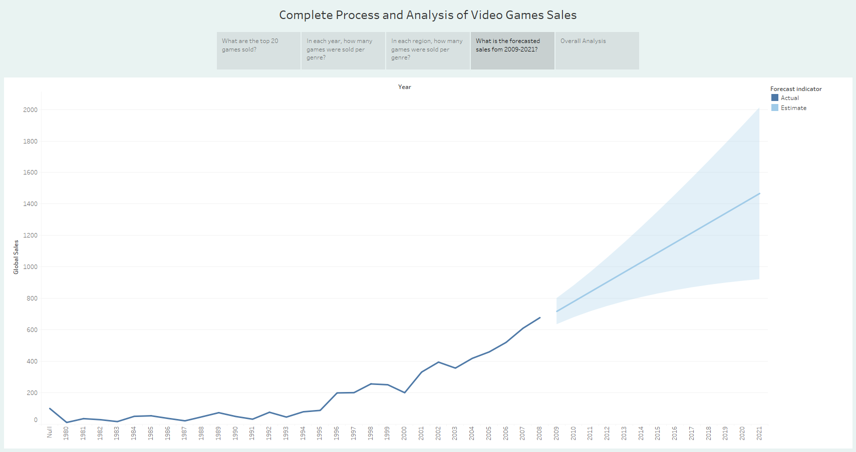

Slide 7
